Slide 1
Predicting Length of Stay at
WiFi Hotspots
Justin Manweiler
Naveen Santhapuri
IBM T. J. Watson Research
Formerly: Duke University
jmanweiler@us.ibm.com
Bloomberg, Formerly:
U. South Carolina, Duke
naveenu@gmail.com
Romit Roy Choudhury
Srihari Nelakuditi
Duke University
romit.rc@duke.edu
Univ. of South Carolina
srihari@cse.sc.edu
INFOCOM 2013, Wireless Networks 3
April 18, 2013

Slide 2
Mobile Devices
are a pervasive link between networks and humans

Slide 3
Human Behavior
is not random, predictable through pattern recognition

Slide 4
Behavior-aware Networking
Device Sensing + Context Awareness + Network Adaptation

Slide 5
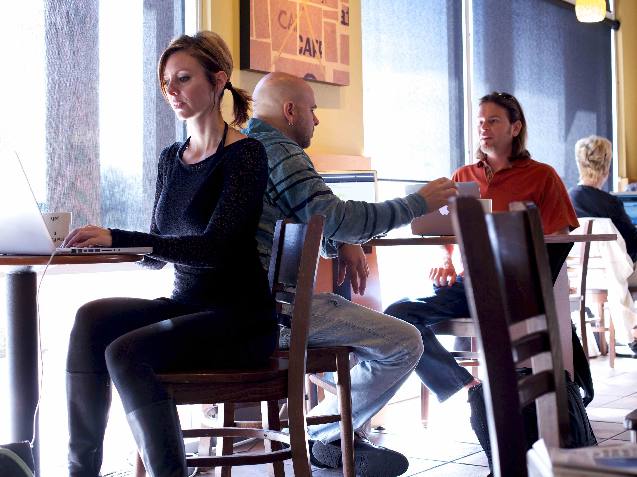
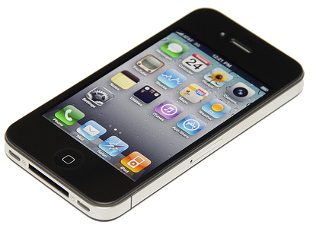
?
?
?
?

Slide 6

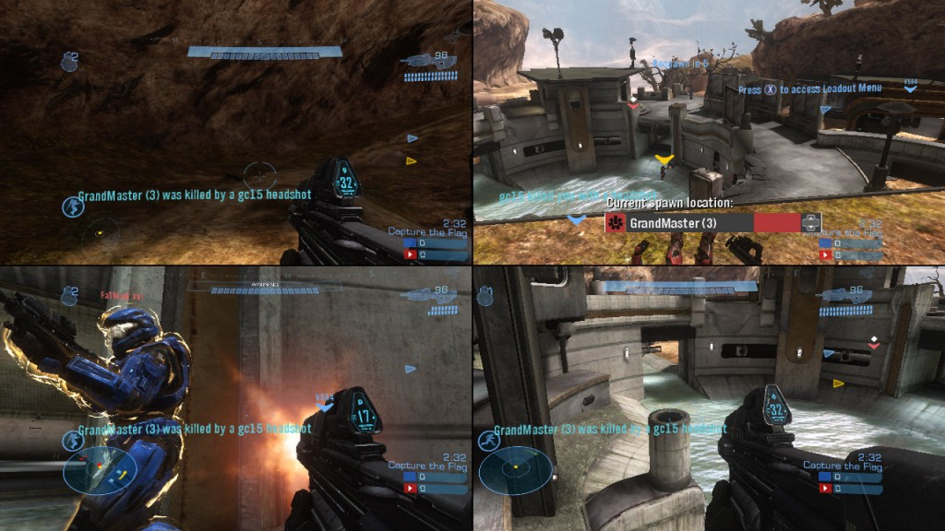

A first attempt…
Matchmaking mobile multiplayer games
Content
Prefetching
Targeted,
Timely Marketing
Length-of-stay (dwell time) prediction

Slide 7
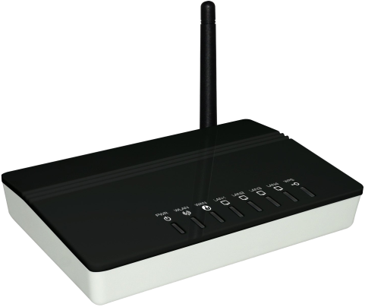




Slide 8
A 50/50 allocation
Is normally fair..
Bandwidth
Time
Customer depart…
Carry-over to 3G/4G
… but unfair here, short-dwell devices leave earlier
Bandwidth
Time
By prioritizing short-dwell,
can equalize service.
Bandwidth
Time

Slide 9



Lots of other applications…
10€ off 100€!
(stay and browse)
50% off Espresso
(on your way to work)

Slide 10

Network
Management
BytesToGo
traffic shaping
ToGo
dwell prediction
Context
Awareness

Slide 11
Large dwell variation in a real café
(opportunity to provide differentiated service)

Slide 12
Still large performance
advantage at hotspots

Slide 13
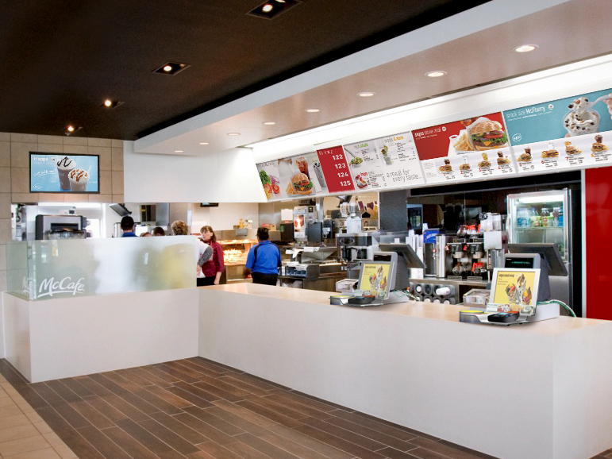

Slide 14





Behavioral patterns
emerge …
…but, weak signal/noise

Slide 15
Simplifying Insight 1
Don’t predict absolute length of stay,
predict logarithmic length of stay class
E.g., at our campus McDonald’s:
(1-2) walking past the restaurant
(2-3) buying food to-go
(4) eating-in
(4-5) studying in the dining area

Slide 16
Simplifying Insight 2
Don’t build a generic classifier,
build a system for learning on-the-fly
Ground truth learned as devices associate/disassociate from WiFi

Slide 17
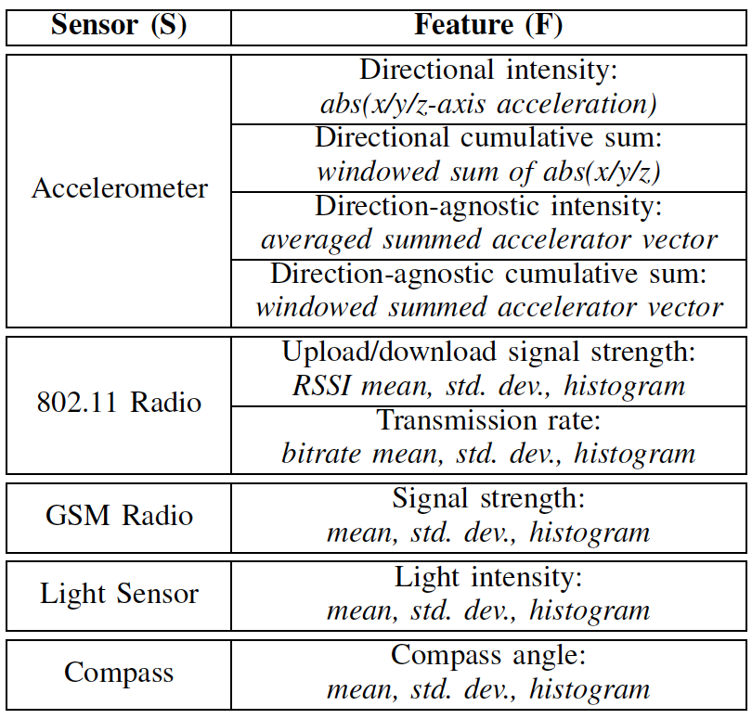
Machine Learning on Cloud/let

Slide 18
Meta-predictor selects
best feature-predictors
Sequence Predictor learns how
the Meta-predictor guesses with time
ToGo learns how well a sequence of sensor
classifications correlates to the dwell classification

Slide 19
Comparative Schemes
“Naïve”
predict based on
current dwell duration
Hindsight
NoFeedback (RSSI only)
Basic
Basic+Compass Basic+Compass+Light
How much sensing is enough?

Slide 20
ToGo/BytesToGo Protype
Nexus One phones (client devices)
Custom Android app to report sensor readings
Linux laptop (AP)
hostapd: provide standard 802.11n AP services
Click Modular Router: record RSSI, receive sensor data
libsvm: C++ library used for realtime SVM training/prediction

Slide 21
“Real” users, good results …
but bias from experimental process?

Slide 22

Observing/Replaying Human Mobility
(capturing mobility without impacting it)
8:14pm
8:10pm
8:13pm
8:12pm
8:00pm

Slide 23
More
Feedback
=
Faster
Convergence
(not shown) more users = greater precision

Slide 24
Live Experiment
Customer arrivals/departures
Performance boost
for short-dwell
Minimal impact
for long-dwell

Slide 25
ToGo finds ~2/3
of available 3G/4G
carryover reduction

Slide 26
Natural questions

Slide 27
Greedy users faking sensor readings?
RSSI alone is a strong predictor … possible to
sanity-check against other sensory inputs
Energy overheads?
Saving 3G/LTE can make up battery life; longer-dwell clients can reduce/eliminate sensor reports
Multi-AP Hotspots?
Even better … leverage EWLAN to apply machine learning at a central controller, improve accuracy
What if user delays turning on phone?
Location at which the phone is turned on is likely itself a strong discriminating feature for a quick prediction

Slide 28
Conclusion
Human behavior is far from random, inferable
Behavior awareness can enhance network systems
BytesToGo is initial attempts towards behavior-aware networking
Sensing
Automatic ML training at WiFi APs
Predict length of stay
Auto-optimize network based on behavior prediction

Slide 29
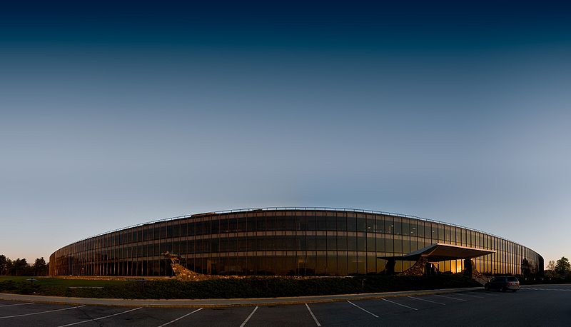
Thank you
Justin Manweiler
Research Staff Member
Thomas J. Watson Research Center
jmanweiler@us.ibm.com
SyNRG Research Group @ Duke
synrg.ee.duke.edu
Quick plug…
Come visit IBM Watson
(talk, intern, fellowships, etc.)

